Slide 1

Time Series Forecasting Platform
(Brent Crude Oil)
Akil Mohamed Firos
Student id - 219015127
MSc AI for Business Intelligence
Academic Supervisor - Andrew Morozov
Sprint 2 - Model Building & Comparison

Slide 2
Table of Contents
Establishing the Benchmark: Linear Model Limitations
Hyperparameter Tuning & Error Reduction
Engineering for Machine Learning: Lags & Log-Space
Performance Comparison
Final Best Model Selection

Slide 3
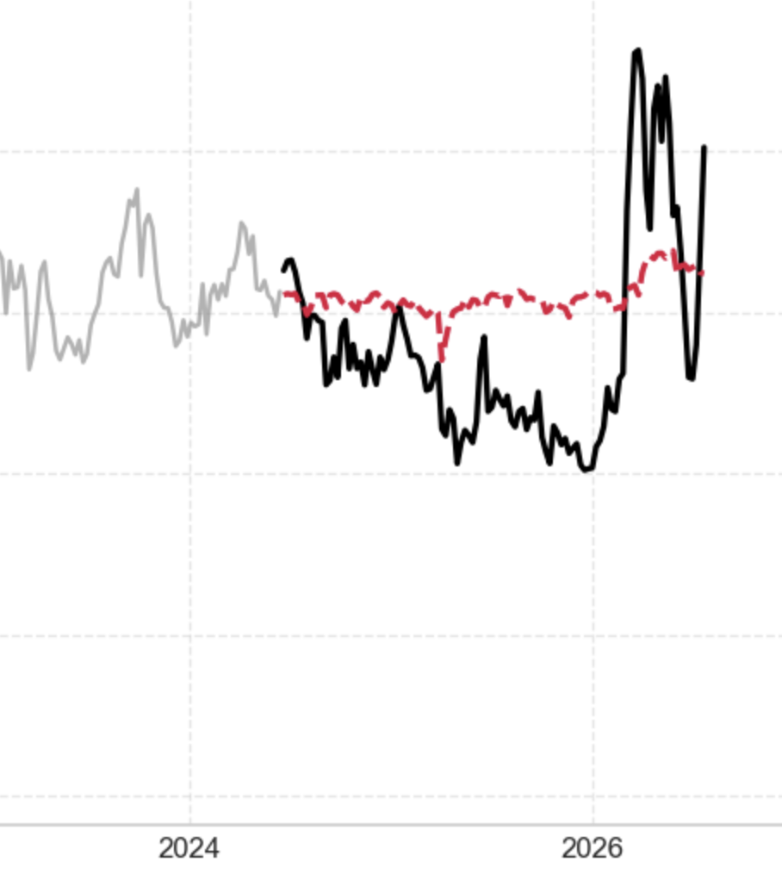
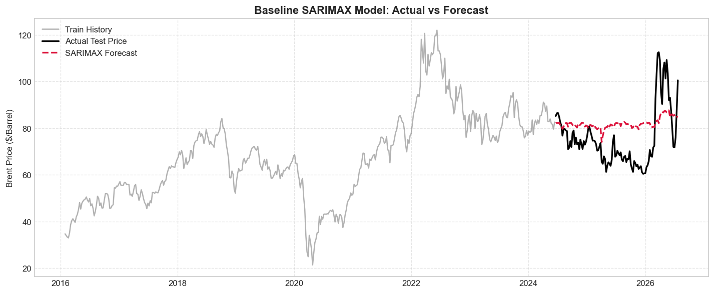
Establishing the Benchmark: Linear Model Limitations
Tested an un-tuned SARIMAX(1, 1, 1) model to establish a foundational performance metric.
Results: Mean Absolute Error (MAE) of $11.29 and a negative R² score (-0.08).
Conclusion: Linear state-space models fail to capture the severe, non-linear volatility of global commodity shocks without continuous rolling updates, in other words resulting $11.29 error and negative R² score mathematically proved our core hypothesis: traditional linear models cannot handle the complex volatility of the oil market.

Slide 4
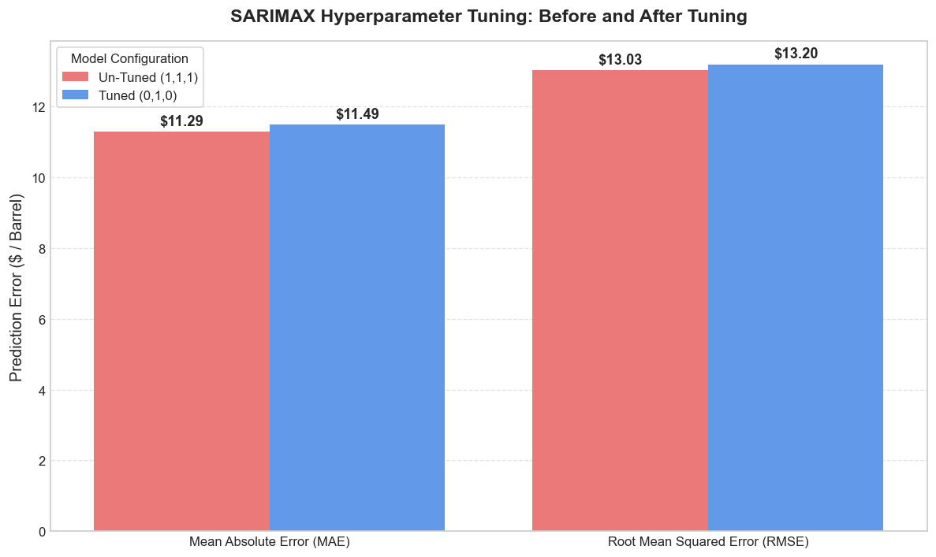
Hyperparameter Tuning & Error Reduction
Deployed an AIC-based Grid Search to rigorously optimize the SARIMAX parameters rather than relying on assumed estimates.
Optimal Configuration: The algorithm identified SARIMAX(0, 1, 0) as mathematically superior.
Impact: Reduced absolute and squared prediction errors, verifying our optimization pipeline works before transitioning to advanced algorithms.
These were the parameters I gave :
  “p” - for how many weeks look back
  “d” - prices changes week to week and this parameter tells me “how many times you must calculate the difference between consecutive weeks to make the overall trend flat which I set to 1 since I have known from sprint 1.2 that Brent_Crude Oil is non-stationery.
  “q” – tells me “how many past forecast errors the model looks at to correct its current trajectory for its next forecast”.
  I put above parameter into the itertool lib to generate diff combination of p,d,q and then ran them into the sarimax model parameter loop for each combination generated.
  The result being the model mathematical superior chosen config.

Slide 5
Engineering for Machine Learning: Lags & Log-Space
Data Transformation: Converted chronological time-series data into a supervised learning matrix.
Lagged Features: Engineered "short-term memory" by feeding the algorithms the exact prices from the previous 1, 2, and 3 weeks.
Target Normalization: Trained all models strictly on Log-Normalized prices (under the var_name Brent_Log) to stabilize extreme variance, converting predictions back to raw US dollars (using the np.expm1) only for final evaluation.
*Calculates log exp(x) - 1 with high precision for numbers close to zero.

Slide 6
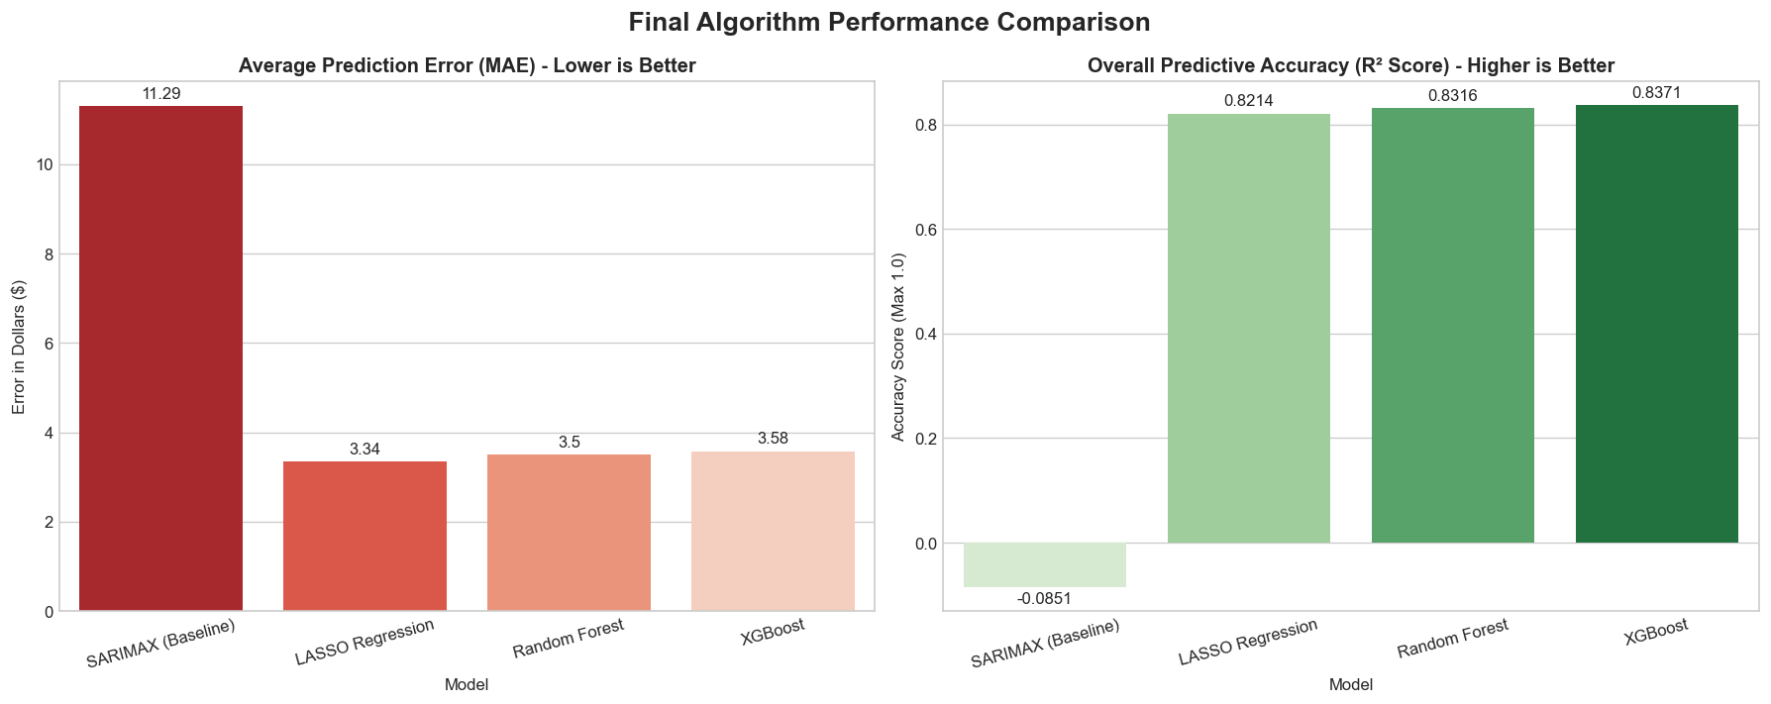
Performance Comparison
The Contenders: SARIMAX vs LASSO Regression (Linear) ,Random Forest & XGBoost (Tree-based ML).
The Improvement: All ML models slashed the $11.29 baseline error down to the ~$3.50 range.
Accuracy Jump: R² scores increased from a failing baseline to explaining over 83% of all market variance.
* The below Bar Chart is output visualization after doing config work on there parameters for each model.

Slide 7
Final Best Model Selection
Model | MAE | RMSE | R^2
SARIMAX (Baseline) | 11.29 | 13.03 | -0.0851 = -0.8%
LASSO Regression | 3.34 | 5.30 | 0.8214 = 82.14%
Random Forest | 3.50 | 5.15 | 0.8316 = 83.16%
XGBoost | 3.58 | 5.06 | 0.8371 = 83.71%
LASSO vs. XGBoost: While LASSO achieved a slightly lower average error ($3.34), XGBoost is the superior architectural choice for volatile commodities.
Why XGBoost Won: Highest overall predictive accuracy (R² = 0.837) and the lowest Root Mean Squared Error (RMSE = 5.06).
Strategic Advantage: The lowest RMSE proves XGBoost is mathematically the safest and most robust model when faced with extreme, unpredictable market panics.
In the next slide a line chart visualization will be available to further understand why XGBoost comes out on top as the best model in the selection.
* Mean Absolute Error (MAE) - tells you exactly how many dollars your model's prediction is off by, on average, every single week. So lower is always better.
* R^2 - tells you what percentage of the wild price swings (volatility) in the oil market your model successfully mapped and predicted.

Slide 8


